Slide 1
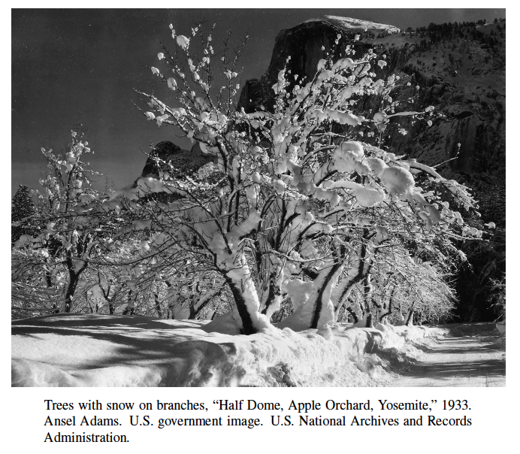
Randomized Algorithms
Presentation for use with the textbook, Algorithm Design and Applications, by M. T. Goodrich and R. Tamassia, Wiley, 2015

Slide 2
Applications: Simple Algorithms and Card Games
A randomized algorithm is an algorithm whose behavior depends, in part, on the outcomes of random choices or the values of random bits.
In addition, there are some problems that need randomization for them to work effectively.
We have already seen randomized algorithms in the context of hash tables, randomized quicksort, and quickselect.
For instance, consider the problem common in computer games involving playing cards—that of randomly shuffling a deck of cards so that all possible orderings are equally likely.

Slide 3
Generating Random Permutations
The input to the random permutation problem is a list, X = (x₁, x₂, . . . , x_{n}), of n elements, which could stand for playing cards or any other objects we want to randomly permute.
The output is a reordering of the elements of X, done in a way so that all permutations of X are equally likely.
We can use a function, random(k), which returns an integer in the range [0, k − 1] chosen uniformly and independently at random.

Slide 4
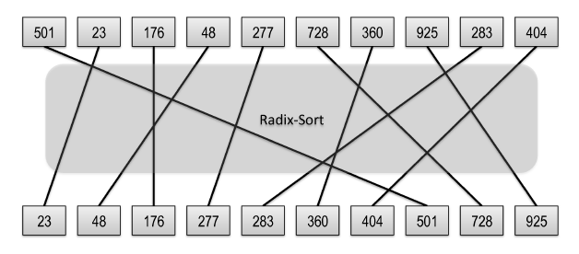
Algorithm 1: Random Sort
This algorithm simply chooses a random number for each element in X and sorts the elements using these values as keys.

Slide 5
Algorithm randonSort
Algorithm randomSort(X):
Input: A list, X, of n elements
Output: A permutation of X so that all permutations are equally likely
Let K be the smallest power of 2 greater than or equal to n³
for each element, x_{i}, in X do
Choose a random value, r_{i}, in the range [0, K − 1] and associate it with x_{i}
Sort X using the r_{i} values as keys via radix-sort
if all the r_{i} values are distinct then
return X according to this sorted order
Else
Call randomSort(X) Algorithm

Slide 6
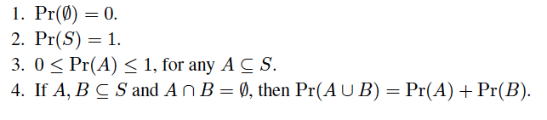
Basic Probability (Sec. 1.2.4)
In order to analyze this, and other randomized algorithms, we need to use probability.
A probability space is a sample space S together with a probability function, Pr, that maps subsets of S to real numbers between 0 and 1, inclusive.
Formally, each subset A of S is an event, and we have the following:

Slide 7
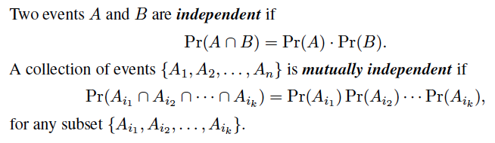
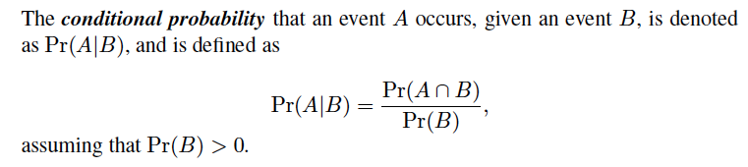
Independence and Conditional Probability

Slide 8


Random Variables
A random variable is a function X that maps outcomes from some sample space S to real numbers.
An indicator random variable is a random variable that maps outcomes to the set {0, 1}.
The expected value of a discrete random variable X is defined as
where the sum is taken of the range of X.
Two random variables X and Y are independent if
for all real numbers x and y.
If two random variables X and Y are independent, then we have E(XY) = E(X)E(Y).

Slide 9
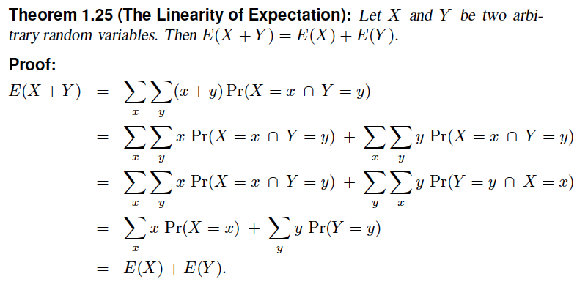
Linearity of Expectation

Slide 10
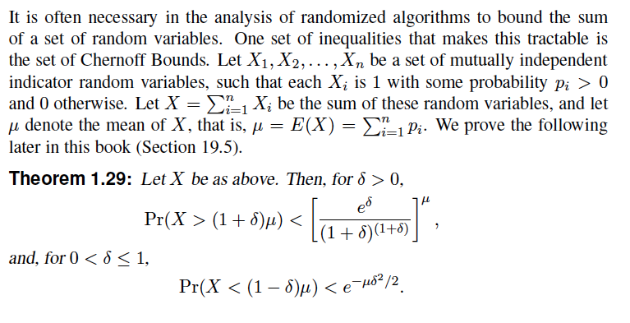
Chernoff Bounds

Slide 11

Analysis of Random-Sort
To see that every permutation is equally likely to be output by the random-sort method, note that each element, x_{i}, in X has an equal probability, 1/n, of having its random r_{i} value be the smallest.
Thus, each element in X has equal probability of 1/n of being the first element in the permutation.
Once we remove the first element, each remaining value has equal probability of 1/n-1.
Applying this reasoning recursively, implies that the permutation that is output has the following probability of being chosen:
That is, each permutation is equally likely to be output.
The probability that any of the r_{i} the same is n/n³ =1/n²
Since n values are chosen, the probability of duplicate is n/n² =1/n

Slide 12
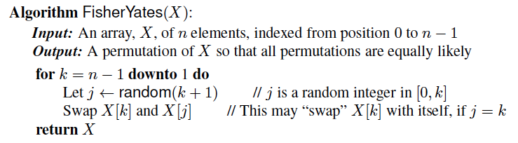
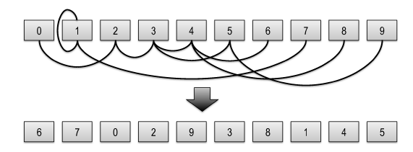
Fisher-Yates Shuffling
There is another algorithm, known as the Fisher-Yates algorithm, which always succeeds, and “almost deterministically”.

Slide 13
Analysis of Fisher-Yates
This algorithm considers the items in the array one at time from the end and swaps each element with an element in the array from that point to the beginning.
Notice that each element has an equal probability, of 1/n, of being chosen as the last element in the array X (including the element that starts out in that position).
Applying this analysis recursively, we see that the output permutation has probability
That is, each permutation is equally likely.

Slide 14
The Coupon Collector Problem
Imagine that there is a set, C, of n coupons and we are interested in collecting at least one of every coupon in C.
We can go to a ticket window once a day and request a coupon, and a clerk will choose one of the n coupons at random and give it to us.
The coupon collector problem is to determine the number of times we need to go to the ticket window before we have collected all n coupons.

Slide 15
Analysis of Coupon Collecting
Let X be a random variable representing the number of times that we need to visit the ticket window before we get all n coupons.
We can write X as follows:
X = X₁ + X₂ + . . . + X_{n},
Here X_{i} is the number of trips we have to make to the ticket window in order to go from having i − 1 distinct coupons to having i distinct coupons.

Slide 16

More Analysis of Coupon Collecting
X₁ = 1, since we are guaranteed to get a distinct coupon in our first trip to the ticket window.
After we have gotten i −1 distinct coupons, our chance of getting a new one in any trip to the window is
This is because there are n coupons, but only n−(i−1) that we don’t already have at this point in time.
This implies that each X_{i} a geometric random variable with parameter, p_{i} (i.e., X_{i} number of attempts to get a success)
That is, if we imagine that we have a biased coin that only comes up heads with probability p_{i}, then X_{i} is the number of times we have to flip this coin until we get it to come up heads.

Slide 17
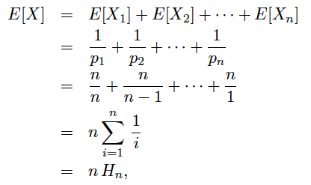
Yet More Analysis of Coupon Collecting
By linearity of expectation,
Here, H_{n} is the nth harmonic number, which is at most ln(n + 1).
Thus, the expected number of trips to the ticket window in the coupon collector problem is O(n log n).

Slide 18
The Stable Marriage Problem
Imagine a village consisting of n men and n women, all of whom are single, heterosexual, and interested in getting married.
Every man has a list of the women ordered by his preferences, and, likewise, every woman has a list of the men ordered by her preferences.
The stable marriage problem is to match up the men and women in a way that is stable.
Such a matching is stable if there is no unmatched man-woman pair, (x, y), such that x and y would prefer to be married to each other than to their spouses.
That is, it would be unstable if x preferred y over his wife and y preferred x over her husband.

Slide 19
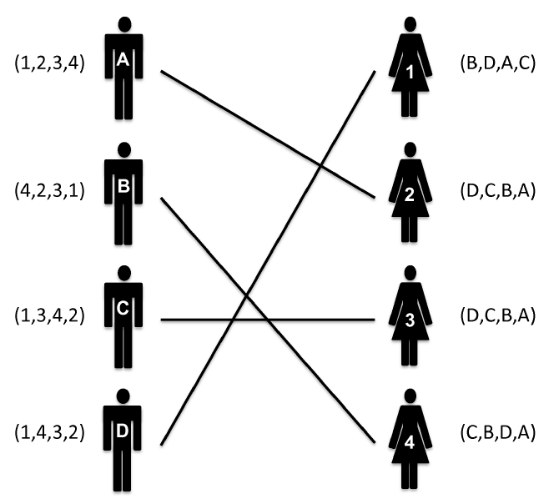
A Stable Marriage Example
Each man and woman is listed with his or her preference list, and the matching shown is stable.
Note that even though female 2 is married to her last choice, there is no man who prefers her over his current wife.

Slide 20
Application: Hospital Matching
The stable marriage problem arises in practice in the annual placement of residents in hospitals.
Residents rank order the hospitals that they would like to work in, and hospitals rank the set of available residents for each of their available open slots.
Then a stable “marriage” is computed between residents and available slots in hospitals.

Slide 21
The Proposal Algorithm
There is a simple algorithm for solving the stable marriage problem, which involves men making proposals to women in a series of rounds.
A round begins with an unmatched man making a proposal to the female highest-ranked on his list.
If she is unmatched, then she accepts his proposal and the round ends. If, on the other hand, she is matched, then she accepts his proposal only if she ranks him higher than her current partner.
In the case when the woman receiving the proposal is already matched, then whichever man she rejects repeats the computation for this round, making a proposal to the next woman on his list (his highest-ranked woman that he has not previously proposed to).

Slide 22
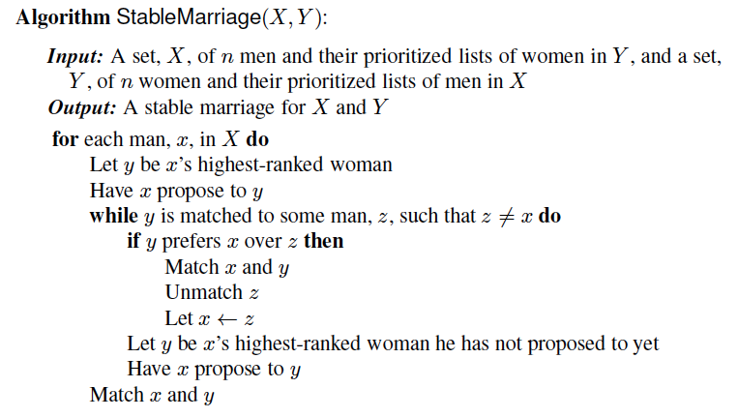
The Proposal Algorithm: Details

Slide 23
Correctness
To see that the matching resulting from this proposal algorithm is stable, suppose there is an unstable pair, (x, y), that are not matched by the algorithm, that is, both x and y prefer each other to the partners they end up with by following the proposal algorithm.
Note that at the time x made his last proposal, to his current partner, w, he had made a proposal to every woman that he ranked higher than w.
But this means that he would have made a proposal to y, which she would have accepted, because she ranks x higher than the man she ended up with.
Thus, such a pair, (x, y), cannot exist.

Slide 24
Worst-Case Analysis
The worst-case running time of this algorithm is O(n²).
To see this fact, note that at the beginning of the algorithm, the total length of the lists of all n men is O(n²), and at each step of the algorithm, some man is using up a proposal to a woman on his list to whom he will never again propose.
Thus, if we charge each entry in the list of preferences by the men 1 cyber-dollar for the work we do in having a man make a proposal, then we can pay for all the proposals using O(n²) cyber-dollars.

Slide 25
Average-Case Analysis
For the sake of average-case analysis, suppose the preference list for every man is an independent random permutation of the list of women.
Then, each time it is a man’s turn to make a proposal, he is making that proposal to a random woman he has not proposed to before.
We can simplify this analysis further so each time it is a man’s turn to make a proposal, he makes his proposal to a random woman ignoring his previous proposals.
Such an algorithm is memoryless, in the sense that each proposal a man makes is independent of any proposal he made earlier.

Slide 26
Average-Case Analysis, cont.
The key observation to analyze the memoryless algorithm is to focus on the women and realize that each round in this algorithm consists of a sequence of proposals to independently chosen random women until a proposal is made to an unmatched woman.
That is, the memoryless algorithm is an instance of the coupon collector problem where the names of the women are the coupons.
Thus, by the analysis of the coupon collector problem, the expected running time of the memoryless stable marriage algorithm is O(n log n).

Slide 27
Minimum Cuts
Presentation for use with the textbook, Algorithm Design and Applications, by M. T. Goodrich and R. Tamassia, Wiley, 2015

Slide 28
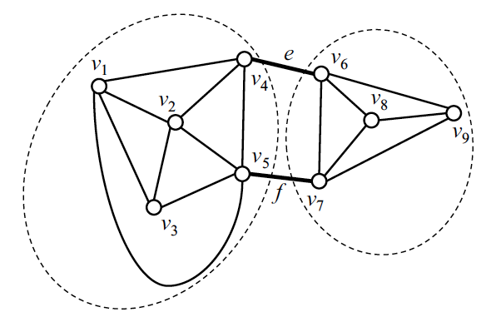
Definition of Minimum Cut
A cut, C, of a connected graph, G, is a subset of the edges of G whose removal disconnects G.
That is, after removing all the edges of C, we can partition the vertices of G into two subsets, A, and B such that there are no edges between a vertex in A and a vertex in B.
A minimum cut of G is a cut of smallest size among all cuts of G.

Slide 29
Applications
In several applications, it is important to determine the size of a smallest cut of a graph.
For example, in a communications network, the failures of the edges of a cut prevents the communication between the nodes on the two sides of a cut.
Thus, the size of a minimum cut and the number of such cuts give an idea of the vulnerability of the network to edge failures.
Small cuts are also important for the automatic classification of web content.
Namely, consider a collection of web pages and model them as a graph, where vertices correspond to pages and edges to links between pages.
The size of a minimum cut provides a measure of how much groups of pages have related content. Also, we can use minimum cuts to recursively partition the collection into clusters of related documents.

Slide 30
Relationship to Max Flow
The min-cut/max-flow theorem states that, given a pair of vertices, s and t, we can compute a minimum cut in polynomial time such that s is on one side of the cut and t is on the other.
In this case, however, we want the minimum cut over all possible cuts.
Nevertheless, we can compute such an overall minimum cut by O(n) calls to an (s,t)-min-cut-max-flow algorithm. (See Exercise C-19.9.)
There is a simple, efficient randomized algorithm that succeeds with high probability without using min-cut-max-flow, but using the concept of Contracting Edges.

Slide 31
Contracting Edges
The simple randomized algorithm repeatedly performs contraction operations on the graph.
Let G be a graph with n vertices, where we allow G to have parallel edges. We denote with (v,w) any edge with endpoints v and w.
The contraction of an edge e of G with endpoints u and v consists of the following steps that yield a new graph with n − 1 vertices, denoted G/e:
Remove edge e and any other edge between its endpoints, u and v.
Create a new vertex, w.
For every edge, f, incident on u, detach f from u and attach it to w. Formally speaking, let z be the other endpoint of f. Change the endpoints of f to be z and w.
For every edge, f, incident on v, detach f from v and attach it to w.

Slide 32
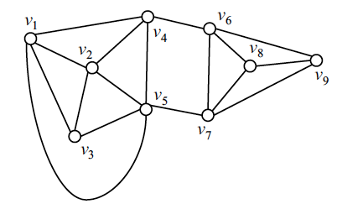
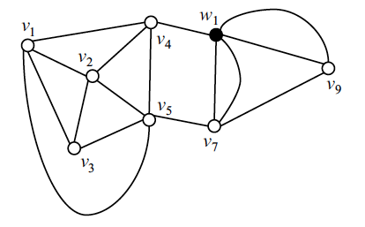
Contracting Edges, An Example
Contracting the edge (v₆,v₈)

Slide 33
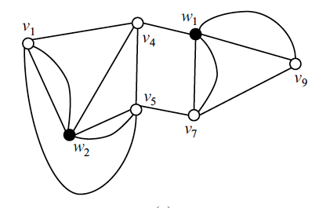
Contracting Edges, An Example
Contracting the edge (v₂,v₃)

Slide 34
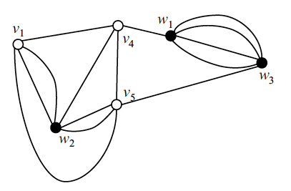
Contracting Edges, An Example
Contracting the edge (v₇,v₉)

Slide 35
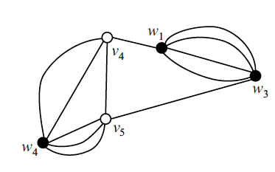
Contracting Edges, An Example
Contracting the edge (v₁,w₂)

Slide 36
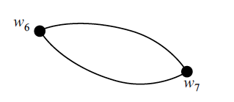
Contracting Edges, An Example
Contracting the edge (v₄,v₅), yielding w₅, contracting (w₄,w₅), yielding w₆, and contracting (w₁,w₃), yielding w₇.
This final graph has the same minimum cut as the original graph.

Slide 37
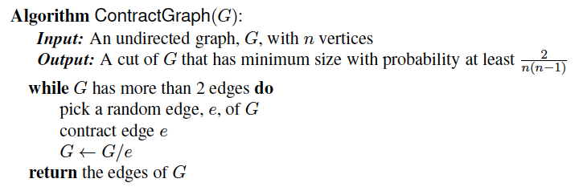
Karger’s Algorithm
A simple min-cut algorithm, which succeeds with high probability is to repeat the following procedure multiple times, keeping track of the smallest cut that it ever finds:

Slide 38
Running Time
Theorem 19.3: Let G be a graph with n vertices. For any positive integer constant c, we can compute a minimum cut of G with randomized algorithm (Karger’s Algorithm) that runs in time O(n⁴ log n), and has a success probability of 1- 1/n^{c} .
Recall Edmonds-Karp Algorithm to find the Max flow (which is equal to Capacity of minimum cut) is O(nm²) which needs to be applied O(n) time to G to find the minimum cut results in O(n²m²).
So Randomized minimum cut is more practical.

Slide 39
Las Vegas and Monte Carlo Algorithms
A randomized algorithm that always succeeds in producing a correct output, but whose running time depends on random events (probabilistic) is known as Las Vegas Algorithm.
Example: randomSort runs in O(n) time with probability
A Randomized algorithm that always has a deterministic running time, but whose output may be incorrect, with some probability, is known as Monte Carlo Algorithm
Example: Fisher –Yates produces shuffles with probability of 1-(1/n!) of equally likely permutation in O(n) time.

Slide 40
More Examples.
Analyze the following Examples.
Randomized QuickSort
Algorithm Sort (X)
While X is not sorted
Shuffle X
What is the running time of Sort(X)?

Slide 41
0/1 Knapsack
We may use randomization to improve a solution:
Use a greedy algorithm to develop a solution then use a randomized algorithm to improve it.
We can employ a greedy algorithm to fill the knapsack first. Then
Remove a randomly chosen item from the knapsack
Replace it with other item, in a greedy approach
If the result is a better solution, keep it, else go back to the previous solution
Repeat this procedure as many times as desired
An optimal solution may not be obtained, but you may get a better one than the original.

Slide 42
Skip Lists
Presentation for use with the textbook, Algorithm Design and Applications, by M. T. Goodrich and R. Tamassia, Wiley, 2015
S₃
−∞
+∞
S₂
−∞
15
+∞
S₁
−∞
15
23
+∞
S₀
−∞
10
15
23
36
+∞

Slide 43
What is a Skip List
A skip list for a set S of distinct (key, element) items is a series of lists S₀, S₁ , … , S_{h} such that
Each list S_{i} contains the special keys +∞ and −∞
List S₀ contains the keys of S in nondecreasing order
Each list is a subsequence of the previous one, i.e., S₀ ⊇ S₁ ⊇ … ⊇ S_{h}
List S_{h} contains only the two special keys
We show how to use a skip list to implement the Dictionary ADT
S₃
−∞
+∞
S₂
−∞
31
+∞
S₁
−∞
23
31
34
64
+∞
S₀
−∞
12
23
26
31
34
44
56
64
78
+∞

Slide 44
Search
We search for a key x in a a skip list as follows:
We start at the first position of the top list
At the current position p, we compare x with y ← key(next(p))
x = y: we return element(next(p))
x > y: we “scan forward”
x < y: we “drop down”
If we try to drop down past the bottom list, we return null
Example: search for 78
S₃
−∞
+∞
scan forward
S₂
−∞
31
+∞
drop down
S₁
−∞
23
31
34
64
+∞
S₀
−∞
12
23
26
31
34
44
56
64
78
+∞

Slide 45
Randomized Algorithms Review
Recall a randomized algorithm performs coin tosses (i.e., uses random bits) to control its execution
It contains statements of the type
b ← random()
if b = 0
do A …
else { b = 1}
do B …
Its running time depends on the outcomes of the coin tosses
We analyze the expected running time of a randomized algorithm under the following assumptions
the coins are unbiased, and
the coin tosses are independent
The worst-case running time of a randomized algorithm is often large but has very low probability (e.g., it occurs when all the coin tosses give “heads”)
We use a randomized algorithm to insert items into a skip list

Slide 46
Insertion
To insert an entry (x, o) into a skip list, we use a randomized algorithm:
We repeatedly toss a coin until we get tails, and we denote with i the number of times the coin came up heads
If i ≥ h, we add to the skip list new lists S_{h+1}, … , S_{i +1}, each containing only the two special keys
We search for x in the skip list and find the positions p₀, p₁ , …, p_{i} of the items with largest key less than x in each list S₀, S₁, … , S_{i}
For j ← 0, …, i, we insert item (x, o) into list S_{j} after position p_{j}
Example: insert key 15, with i = 2
S₃
−∞
+∞
p₂
S₂
−∞
+∞
S₂
−∞
15
+∞
p₁
S₁
−∞
23
+∞
S₁
−∞
15
23
+∞
p₀
S₀
−∞
10
23
36
+∞
S₀
−∞
10
15
23
36
+∞

Slide 47
Deletion
To remove an entry with key x from a skip list, we proceed as follows:
We search for x in the skip list and find the positions p₀, p₁ , …, p_{i} of the items with key x, where position p_{j} is in list S_{j}
We remove positions p₀, p₁ , …, p_{i} from the lists S₀, S₁, … , S_{i}
We remove all but one list containing only the two special keys
Example: remove key 34
S₃
−∞
+∞
p₂
S₂
−∞
34
+∞
S₂
−∞
+∞
p₁
S₁
−∞
23
34
+∞
S₁
−∞
23
+∞
p₀
S₀
−∞
12
23
34
45
+∞
S₀
−∞
12
23
45
+∞

Slide 48
Implementation
We can implement a skip list with quad-nodes
A quad-node stores:
entry
link to the node prev
link to the node next
link to the node below
link to the node above
Also, we define special keys PLUS_INF and MINUS_INF, and we modify the key comparator to handle them
quad-node
x

Slide 49
Space Usage
Consider a skip list with n entries
By Fact 1, we insert an entry in list S_{i} with probability 1/2^{i}
By Fact 2, the expected size of list S_{i} is n/2^{i}
The expected number of nodes used by the skip list is
The space used by a skip list depends on the random bits used by each invocation of the insertion algorithm
We use the following two basic probabilistic facts:
Fact 1: The probability of getting i consecutive heads when flipping a coin is 1/2^{i}
Fact 2: If each of n entries is present in a set with probability p, the expected size of the set is np
Thus, the expected space usage of a skip list with n items is O(n)

Slide 50
Height
The running time of the search an insertion algorithms is affected by the height h of the skip list
We show that with high probability, a skip list with n items has height O(log n)
We use the following additional probabilistic fact:
Fact 3: If each of n events has probability p, the probability that at least one event occurs is at most np
Consider a skip list with n entires
By Fact 1, we insert an entry in list S_{i} with probability 1/2^{i}
By Fact 3, the probability that list S_{i} has at least one item is at most n/2^{i}
By picking i = 3log n, we have that the probability that S_{3log n} has at least one entry is at most n/2^{3log n} = n/n³ = 1/n²
Thus a skip list with n entries has height at most 3log n with probability at least 1 − 1/n²

Slide 51
Search and Update Times
The search time in a skip list is proportional to
the number of drop-down steps, plus
the number of scan-forward steps
The drop-down steps are bounded by the height of the skip list and thus are O(log n) with high probability
To analyze the scan-forward steps, we use yet another probabilistic fact:
Fact 4: The expected number of coin tosses required in order to get tails is 2
When we scan forward in a list, the destination key does not belong to a higher list
A scan-forward step is associated with a former coin toss that gave tails
By Fact 4, in each list the expected number of scan-forward steps is 2
Thus, the expected number of scan-forward steps is O(log n)
We conclude that a search in a skip list takes O(log n) expected time
The analysis of insertion and deletion gives similar results

Slide 52
Summary
A skip list is a data structure for dictionaries that uses a randomized insertion algorithm
In a skip list with n entries
The expected space used is O(n)
The expected search, insertion and deletion time is O(log n)
Using a more complex probabilistic analysis, one can show that these performance bounds also hold with high probability
Skip lists are fast and simple to implement in practice

